Slide 1

[DEPARTMENT] · AI JOURNEY
Our AI journey starts below the waterline
Why our AI program starts with data, calculations and tools, not just agents
[Presenter] · [Date]
Notes:
Framing: the AI conversation fixates on agents and automation. This deck argues the durable advantage is built underneath, and lays out how we invest.

Slide 2
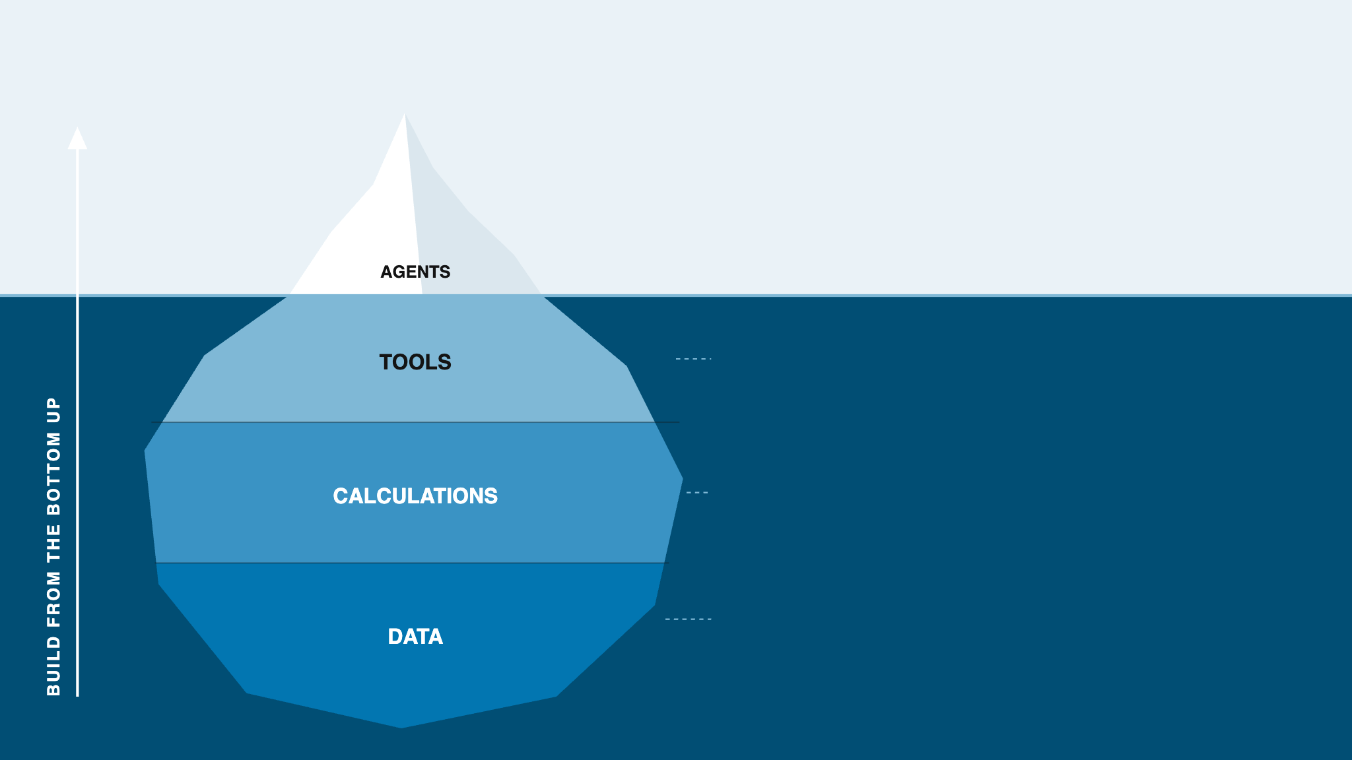
We build agentic workflows from the bottom up
ABOVE THE SURFACE · WHAT PEOPLE SEE
Agents and automated workflows only work when they rest on a solid foundation
BELOW THE SURFACE · WHAT MAKES IT WORK
Tools agents actually use
Reliable, well-documented systems and APIs that people and agents can both call
Standardized calculations
One validated definition per metric, reused everywhere instead of rebuilt each time
Data foundation
Trusted, governed, quality-monitored data that everything above depends on
Notes:
We invest in both parts of the iceberg: we do build agents and automated workflows. What we don't do is chase the visible tip on its own. An agent is only as good as the tools it can call, the calculations it relies on and the data underneath. If those layers are weak, every agent inherits the weakness; if they are strong, each new agent is cheaper, faster and safer to build. So we build from the bottom up: foundation first, and applications on top of it.

Slide 3
We invest on two tracks: stronger foundations and leaner workflows
01 · STRENGTHEN THE FOUNDATION
02 · RE-ENGINEER WORKFLOWS
Use AI to build what sits below the waterline, faster
Use agentic workflows to remove friction from how we work
Make the data foundation more solid
Map workflows for friction and inefficiency
e.g., Project Gordius
e.g., deal approval, model build, allowance analysis
Standardize and validate key calculations
Let agents take over repetitive steps
e.g., Commercial Calculation project
e.g., Cyber Credit Officer for deal approval
Make our tooling more useful and reusable
Humans drive the process and stay in the loop
e.g., [tooling project]
e.g., officers review and decide on every deal
Payoff: helps our people today and every agent we build tomorrow
Payoff: faster, more efficient processes with people in control
Notes:
Track 1 uses AI to accelerate the foundational work itself: data quality, standardized calculations, and better tools. That benefits human users now and agents in the long run. Track 2 looks at our workflows, finds the friction and repetitive steps, and uses agentic workflows to take them over, with humans driving the process and staying in the loop. The two reinforce each other: every foundation improvement makes the agents in Track 2 more reliable.

Slide 4
We start with three core credit workflows
01 · CREDIT
02 · MODELING
03 · ALLOWANCE
Deal approval
Loss forecast models
Forecast outcome analysis
Summarize what credit officers need to make a decision, so deals get approved faster
Use AI across model development, and speed deployment to the enterprise platform
Turn forecast results into insight within the tight quarterly window before earnings
Pull deal, borrower and industry information together
Draft the decision summary for review
Credit officer keeps the final call
Accelerate every stage of model development
Streamline deployment to the enterprise platform
[Add a third focus area]
Explain what changed and what drove it
Draft recommendations
Summarize for senior leaders
Outcome: faster approvals, same credit discipline
Outcome: a shorter path from model build to production
Outcome: fewer trade-offs under deadline, a clearer story
All three run on the same foundation: data, standardized calculations and tools
Notes:
Three use cases tied to our commercial banking work. 1) Deal approval: help credit officers get the information they need summarized so they can decide and approve deals faster. 2) Loss forecast model development and deployment: use AI to accelerate every part of model development and to deploy models to the enterprise platform. 3) Loss forecast outcome analysis: after the forecast runs, quickly explain what changed, identify the drivers and make recommendations. This work happens in a very short window, for example the quarterly allowance process that must finish before earnings, which has forced trade-offs in the past. The output also has to be summarized so senior leaders can consume it.

Slide 5
AI could halve the effort behind each deal
TODAY
STEP · ONE DEAL
HRS
−56%
34 hrs
Intake & documents
3 → 1
Gather financials, KYC and deal terms
FTE hours per deal
Financial spreading
5 → 2
WHAT MOVES THE BARS
Spread and normalize statements
Cash flow & debt capacity
5 → 2
Unified borrower and deal data
DSCR, leverage and downside cases
Intake, spreading
WITH AI
Collateral & structure
3 → 2
Collateral values, covenants, terms
Standardized credit calculations
15 hrs
Industry & peer analysis
4 → 1
Cash flow, collateral, rating
Industry outlook, peer benchmarks
Risk rating
2 → 1
Industry risk research agent
PD / LGD rating with rationale
Industry and peer analysis
Credit memo
8 → 3
Write the recommendation narrative
Credit memo drafting agent
Committee review & approval
4 → 3
Credit memo, committee prep
Challenge, Q&A and final decision
HOW OFTEN
[Hundreds of] deals per year
Small effort per deal, repeated many times
Bars show FTE hours for a single deal · Placeholder estimates, to be replaced with measured figures
Notes:
Bars and the step table measure one deal only; frequency is shown separately in the band below. Placeholder assumptions: a mid-size commercial credit deal takes about 34 FTE hours across relationship, analyst and credit officer time. Bars are to scale at about 14 px per hour: when you replace a number, set that segment's height to hours x 14. Committee review shrinks least because the credit officer and committee keep the decision.

Slide 6
AI could halve the effort behind each model
TODAY
STEP · ONE MODEL
HRS
−56%
1,500 hrs
Data sourcing & exploration
180 → 80
Pull history, profile, spot gaps
FTE hours per model
Data cleaning & prep
300 → 120
WHAT MOVES THE BARS
Fix breaks, outliers, build datasets
Segmentation & variables
150 → 80
Curated, quality-monitored data
Segments, drivers, macro candidates
Sourcing, cleaning
WITH AI
Model estimation
150 → 70
Specify and fit candidate models
Standardized calculation library
660 hrs
Testing & outcome analysis
Variables, testing
Backtests, stability, sensitivity
200 → 90
Documentation
250 → 90
AI coding assistants (Claude Code)
Development doc for model risk
Estimation, testing, documentation
Validation support
120 → 70
Answer MRM findings and challenge
Automated deployment pipeline
Implementation & deployment
150 → 60
Implementation and deployment
Release on the enterprise platform
HOW OFTEN
[1–2] models per year
Large effort per model: about 3 FTEs for 3 months
Bars show FTE hours for a single model · Placeholder estimates, to be replaced with measured figures
Notes:
Bars and the step table measure one model only; frequency is shown separately in the band below. Sizing: one FTE-year is about 2,000 working hours, so 1,500 FTE hours is roughly 3 FTEs for 3 months. Bars are to scale at 0.32 px per hour: when you replace a number, set that segment's height to hours x 0.32. The biggest savings come from data sourcing and cleaning (data foundation) and from coding, testing and documentation (AI coding assistants). Segmentation and model design stay human-led.

Slide 7
AI could cut each quarter's analysis by 60%
TODAY
STEP · ONE QUARTER
HRS
−61%
760 hrs
Collect run results
60 → 20
Gather outputs across portfolios
FTE hours per quarterly cycle
Reconcile & QC
100 → 30
WHAT MOVES THE BARS
Tie out to source, check anomalies
Change analysis
140 → 50
Standardized forecast output data
QoQ movement by portfolio, segment
Collect, reconcile
Driver attribution
180 → 60
WITH AI
Volume, mix, macro, credit quality
Standard attribution calculations
300 hrs
Sensitivity & scenarios
80 → 30
Change analysis, attribution
What-ifs behind the key drivers
Overlay recommendations
60 → 50
Outcome analysis agent
Propose management adjustments
Drivers, scenarios, overlays
Leadership summary
100 → 30
Narrative and exhibits for leaders
Auto-drafted leadership summary
Review & challenge
40 → 30
Leadership summary, review
Senior review, iterate, sign-off
HOW OFTEN
4 cycles per year
Each inside a [~2-week] window before earnings
Bars show FTE hours for a single quarterly cycle · Placeholder estimates, to be replaced with measured figures
Notes:
Bars and the step table measure one quarterly allowance cycle only; frequency is shown separately in the band below. Placeholder assumptions: about 760 FTE hours of post-forecast analysis per quarter, squeezed into a short window before earnings. Bars are to scale at about 0.63 px per hour: when you replace a number, set that segment's height to hours x 0.63. Overlay recommendations and final review shrink least because they need human judgment. The point for leadership is not only fewer hours: within the same window the team can go deeper on drivers instead of trading depth for speed.

Slide 8
Unified data, standard calculations and drafting agents could halve each deal's effort
34 hrs
−56%
TODAY · ONE DEAL
effort per deal
Intake & documents
3
[Hundreds] deals a year
Financial spreading
5
HOW WE MOVE THE BARS
Cash flow analysis
5
Unified borrower data
Collateral & structure
3
Financials and KYC arrive pre-loaded
15 hrs
WITH AI
Industry & peers
4
Standard credit calculations
Risk rating
2
One engine for spreads, DSCR and ratings
Industry research agent
Credit memo
8
Drafts industry and peer views on demand
Credit memo agent
Committee review
4
Drafts the memo; the officer edits and decides
FTE hours · placeholder estimates · colored squares show which steps each project shrinks
Notes:
Left: FTE hours for one deal today, by step. Right: the same steps with AI, same scale and colors. Middle: the reduction per deal, how often deals happen, and the four projects that move the bars; the colored squares on each card match the bar segments that project shrinks. Full step-level detail is on the earlier deal approval slide.

Slide 9
Curated data, shared calculations and Claude Code could halve model build and deployment effort
1,500 hrs
−56%
TODAY · ONE MODEL
build + deploy effort per model
[1–2] models a year
Data sourcing
180
Data cleaning
300
HOW WE MOVE THE BARS
Curated, monitored data
Segments & variables
150
Clean, documented history ready to use
660 hrs
WITH AI
Model estimation
150
Standard calculation library
Reusable, validated metrics and tests
Testing & backtesting
200
Claude Code for modelers
Writes code, tests and draft documents
Documentation
250
Automated deployment
Validation support
120
One-click release to enterprise platform
Deployment
150
FTE hours · placeholder estimates · colored squares show which steps each project shrinks
Notes:
Left: FTE hours for one model today, by step (about 3 FTEs for 3 months). Right: the same steps with AI, same scale and colors. Middle: the reduction per model, how often we build models, and the four projects that move the bars; the colored squares on each card match the bar segments that project shrinks. Full step-level detail is on the earlier model development slide.

Slide 10
Standard outputs and an analysis agent could cut quarterly allowance analysis by 60%
760 hrs
−61%
TODAY · ONE QUARTER
effort per quarter
4 a year, [~2-week] window
Collect results
60
Reconcile & QC
100
HOW WE MOVE THE BARS
Change analysis
140
Standard forecast outputs
Results land in one reconciled format
Standard attribution calcs
WITH AI
300 hrs
Driver attribution
180
Changes split by driver automatically
Outcome analysis agent
Scenarios & what-ifs
80
Explains drivers and runs what-ifs
Overlay recommendations
60
Auto-drafted summary
Leadership summary
100
Exec-ready narrative and exhibits
Review & sign-off
40
FTE hours · placeholder estimates · colored squares show which steps each project shrinks
Notes:
Left: FTE hours for one quarterly allowance cycle today, by step. Right: the same steps with AI, same scale and colors. Middle: the reduction per quarter, how often it happens, and the four projects that move the bars; the colored squares on each card match the bar segments that project shrinks. Full step-level detail is on the earlier outcome analysis slide.

